Slide 1
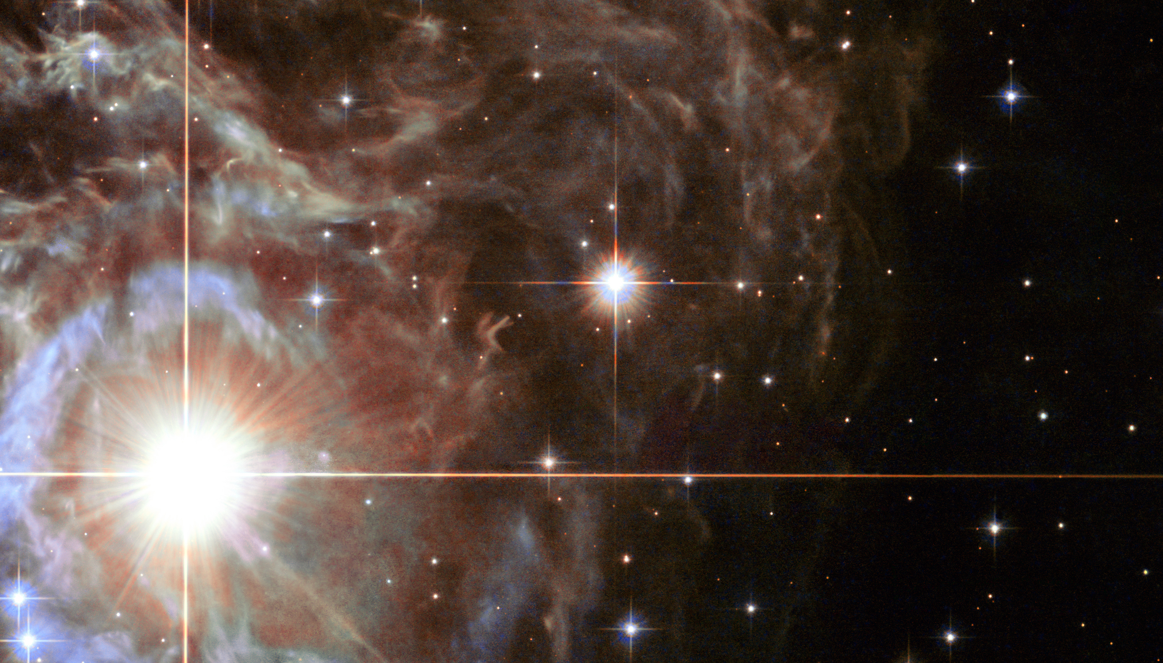


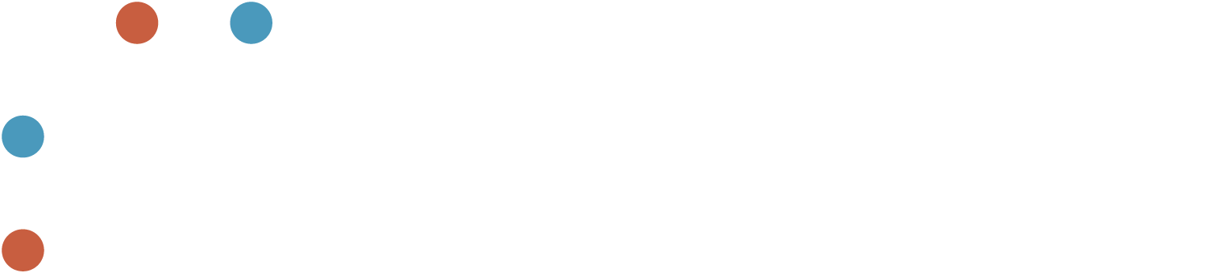
On H0 measurements using Cepheids and the TRGB method
Richard I. Anderson
richard.anderson@epfl.ch

Slide 2
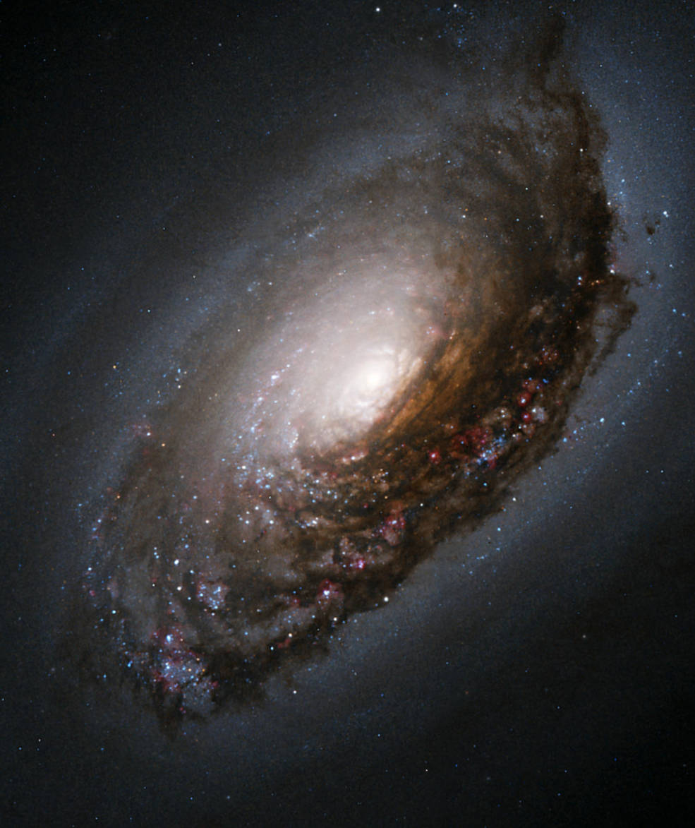
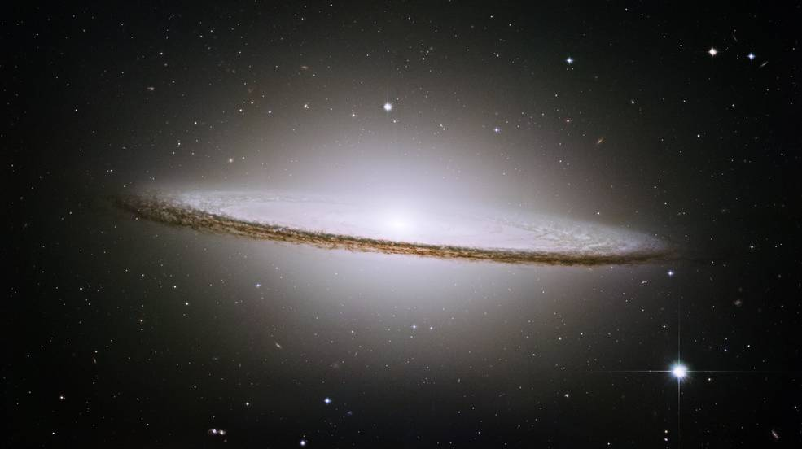
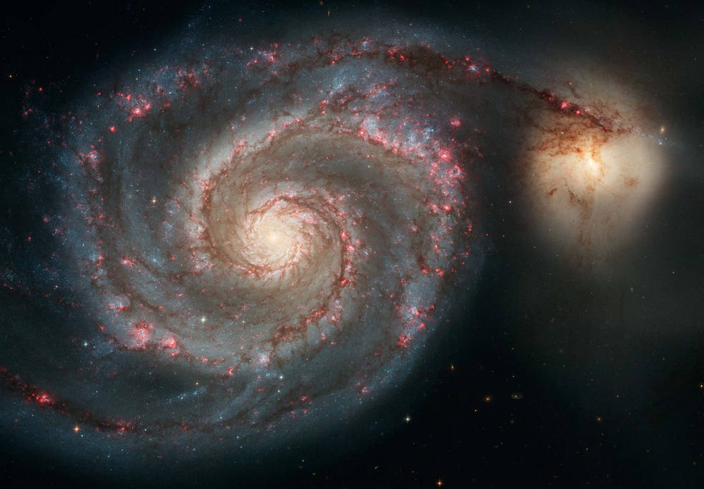
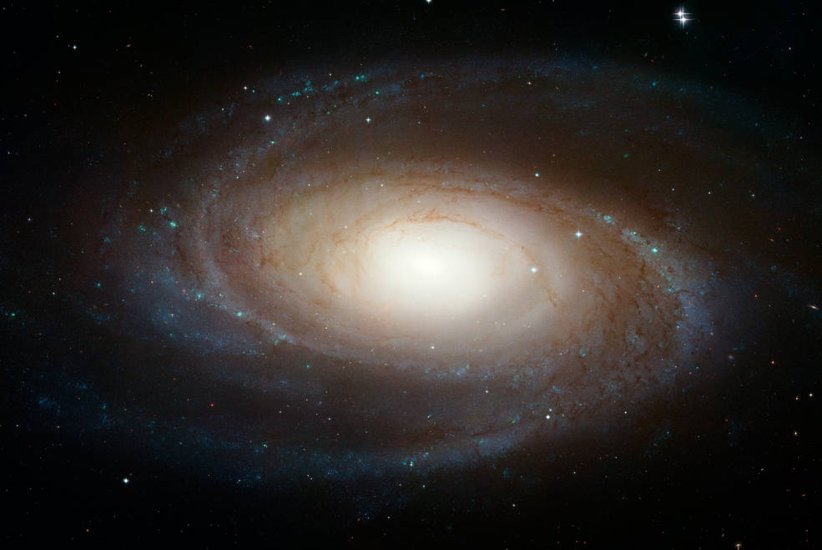
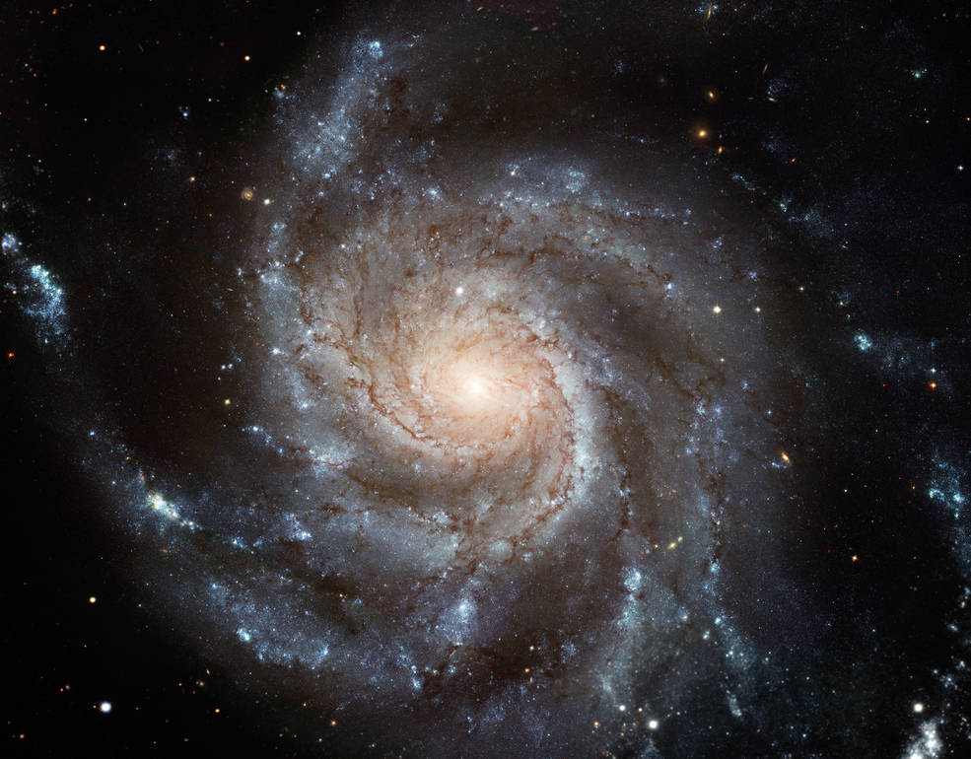

Hubble’s Constant H₀ measures the expansion rate of the Universe today
$$H_{0}=v/D$$
$$D_{L}=\frac{cz}{H_{0}}\left\{1+\frac{1}{2}\left(1−q_{0}\right)z−\frac{1}{6}\left[1−q_{0}−3q_{0}^{2}+j_{0}±\frac{c^{2}}{H_{0}^{2}R^{2}}\right]z^{2}+O\left(z^{3}\right)\right\}$$
expands

Slide 3
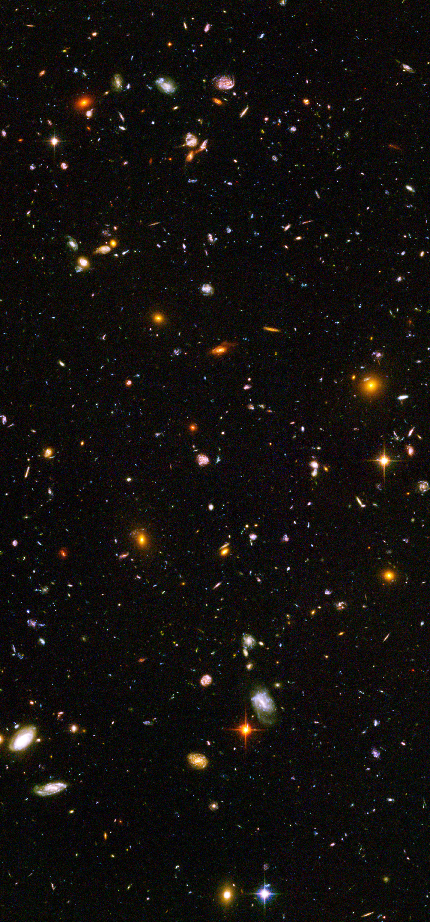
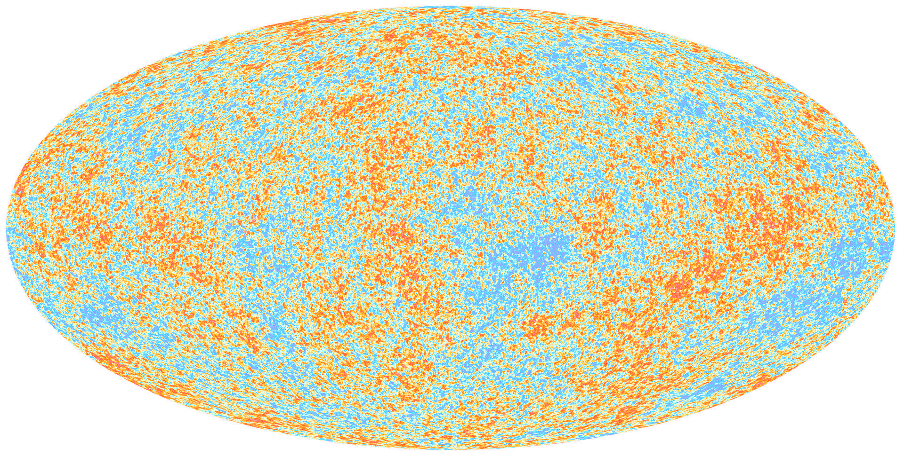
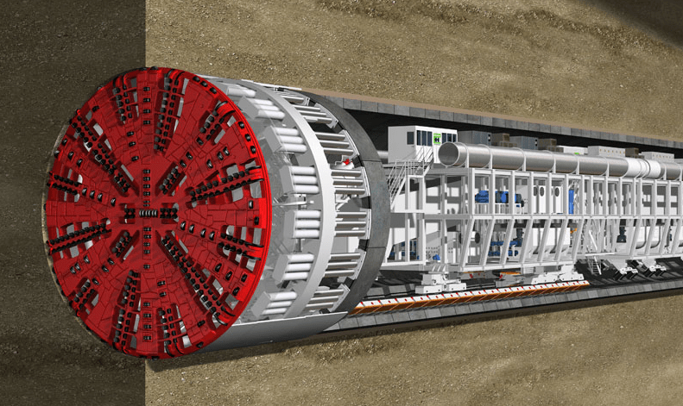

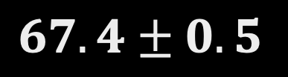
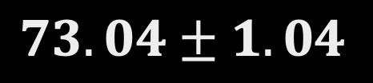
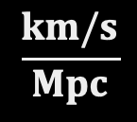

The Early Universe
H₀ as a cosmological end-to-end test
Today’s Universe
$$H_{0}=$$
$$73.04±1.04$$
New Physics???
8.0% / 0.167 mag / 5.0$σ$
$$67.4±0.5$$
$$\frac{km/s}{Mpc}$$
Planck VI (2018)
Riess et al. (2022)
Notes:
H0 is a failing end-to-end test of cosmology that is failing! One option, measurements are wrong, other: new physics
Motivate the need for 1% H0 measurement
Most discrepant is Hubble discord
Other good example: S8 (structure growth) tension, KiDS-1000 (July2020) showed that Universe is less clumpy that LCDM predicts
As PhD student in Geneva, I read Thomas Kuhn’s Structure, which reminds us that a crisis is needed to achieve a paradigm shift…. So is this what’s going on here? Or are we making a mistake somewhere?
Implications:
Age of Universe differs by 1 Gyr depending on H0 value (slower H0 = older Universe)
Dark Energy experiments cannot currently use H0 as prior for analysis (would improve their figure of merit by ~40%)
Impact for particle physics? Number of effective neutrino species could partially resolve H0 (but causes trouble elsewhere)

Slide 4
Hubble tension … … sounds familiar?
Then and now, two very different problems

Slide 5
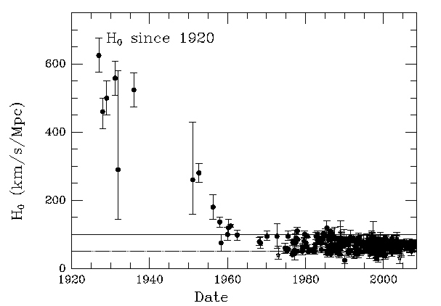
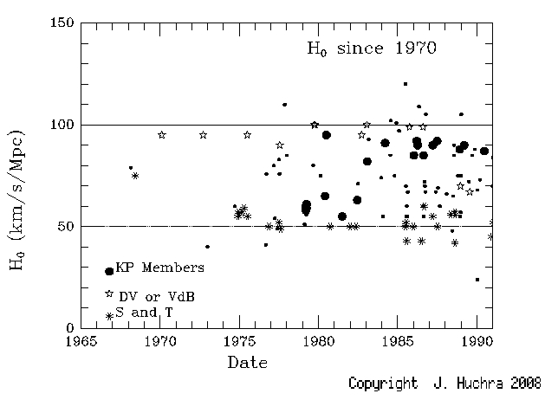
The chequered history of Hubble’s constant

Slide 6
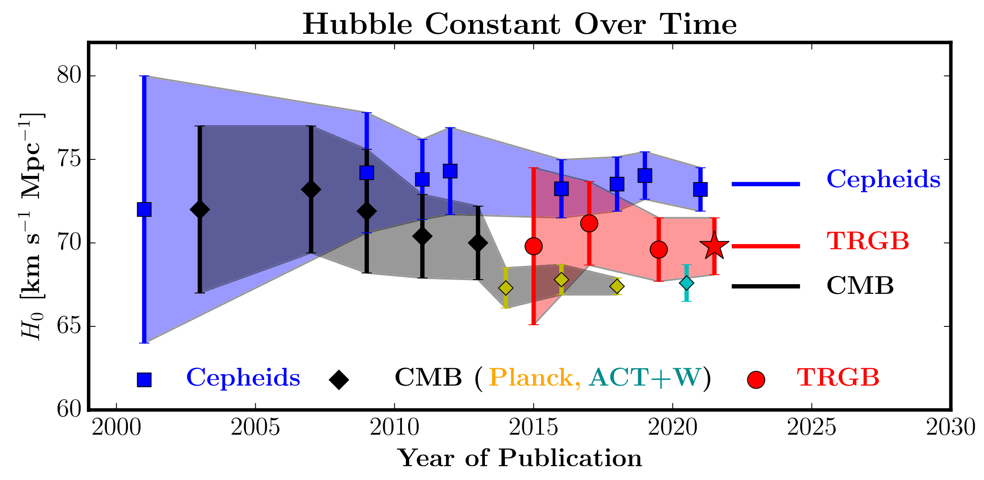
Storytelling…
Freedman (2021)

Slide 7
The bigger picture
Cosmology intertwined, arXiv: 2203.06142

Slide 8
How does the distance scale measure H0?

Slide 9
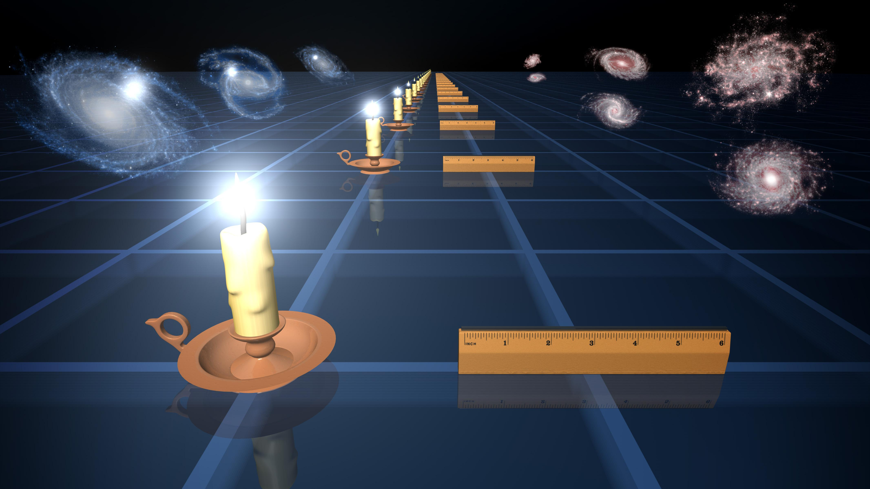

$$μ=m −M=5\log{d }+25$$

Slide 10
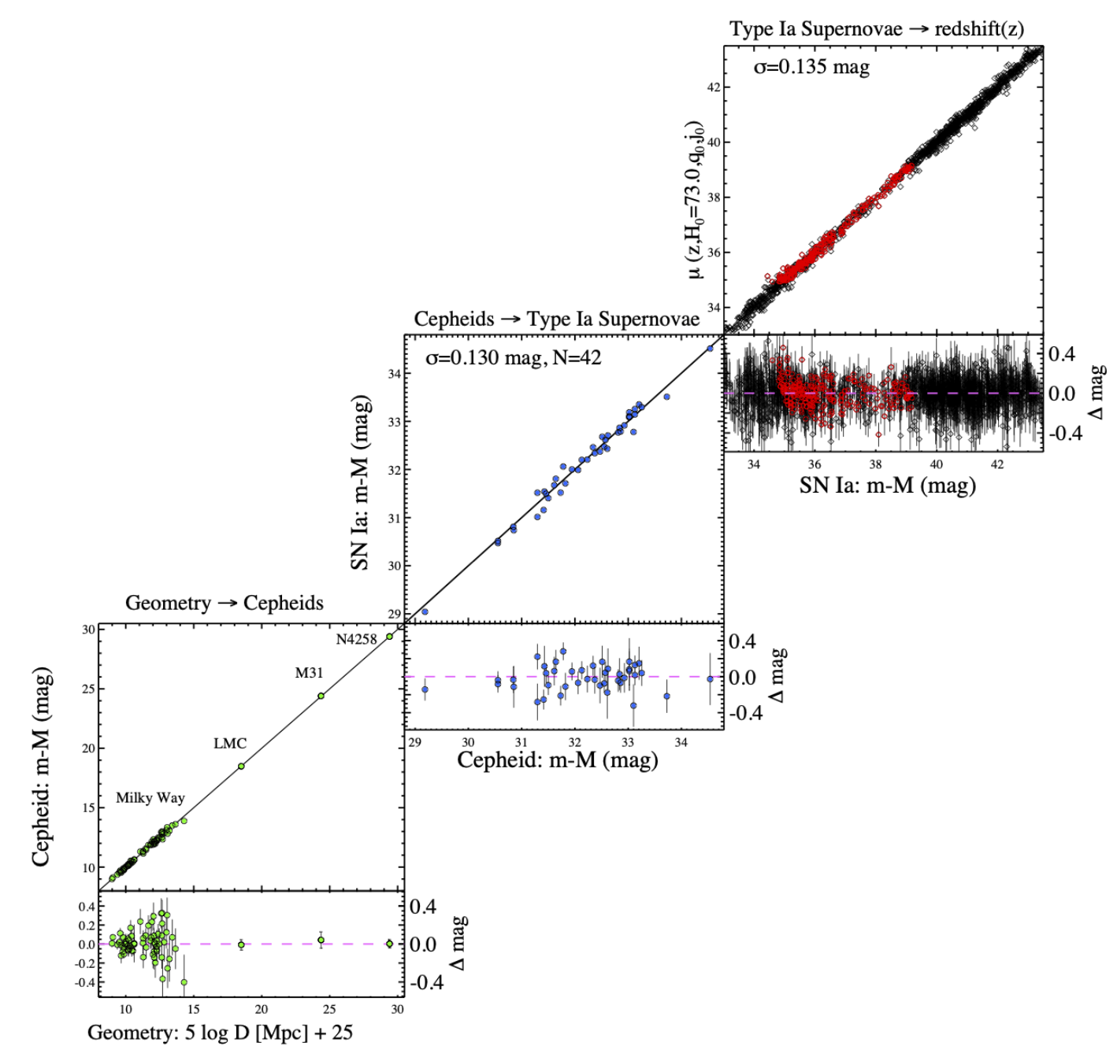
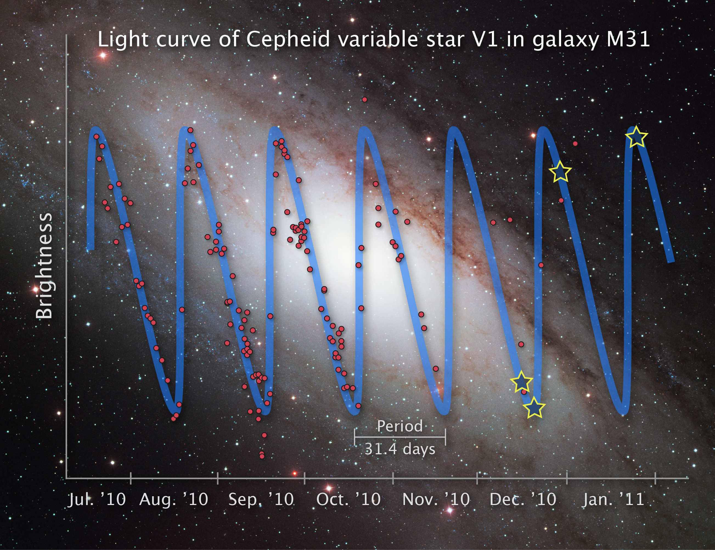
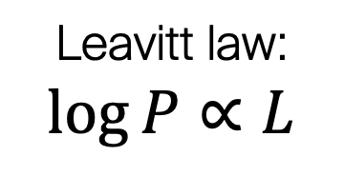
Cepheids link cosmology to geometry
SNeIa in Hubble flow
SN
Close enough for Cepheids, far enough for SNeIa
Gaia Parallaxes
Leavitt law:
$$\log{P}∝L$$
Notes:
Type-Ia Supernovae (SNeIa, Dan Scolnic’s talk) : rare, extremely bright, distant => trace cosmic expansion
Cepheids : plentiful, easily recognized, nearby => calibrate SNeIa
Gaia : anchor Cepheid Period-Luminosity relation to trigonometry

Slide 11
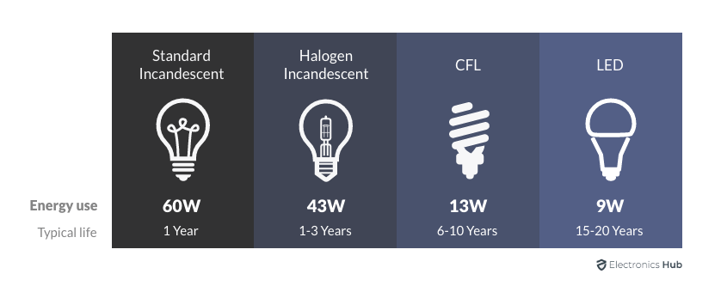
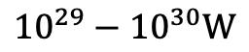
Classical Cepheids are great for this!
Each Cepheid a standard candle
Characteristic variability identifies individual Cepheids
Minimal contamination of PL-sequences by non-Cepheids
Tight scatter in PL relation constrains uncertainties
Exciting modulated variability no challenge to accuracy (e.g. Smolec 2017)
Comparatively well understood by stellar evolution cf. predictions & comprehensive tests in RIA+2016, A&A 591, A8
log(P)
$${10}^{29}−{10}^{30}W$$
Notes:
e.g. PL-relation, instability strip in HRD, period distributions, rates of period change, metallicity effect, period-radius relation, period-mass relation, see

Slide 12
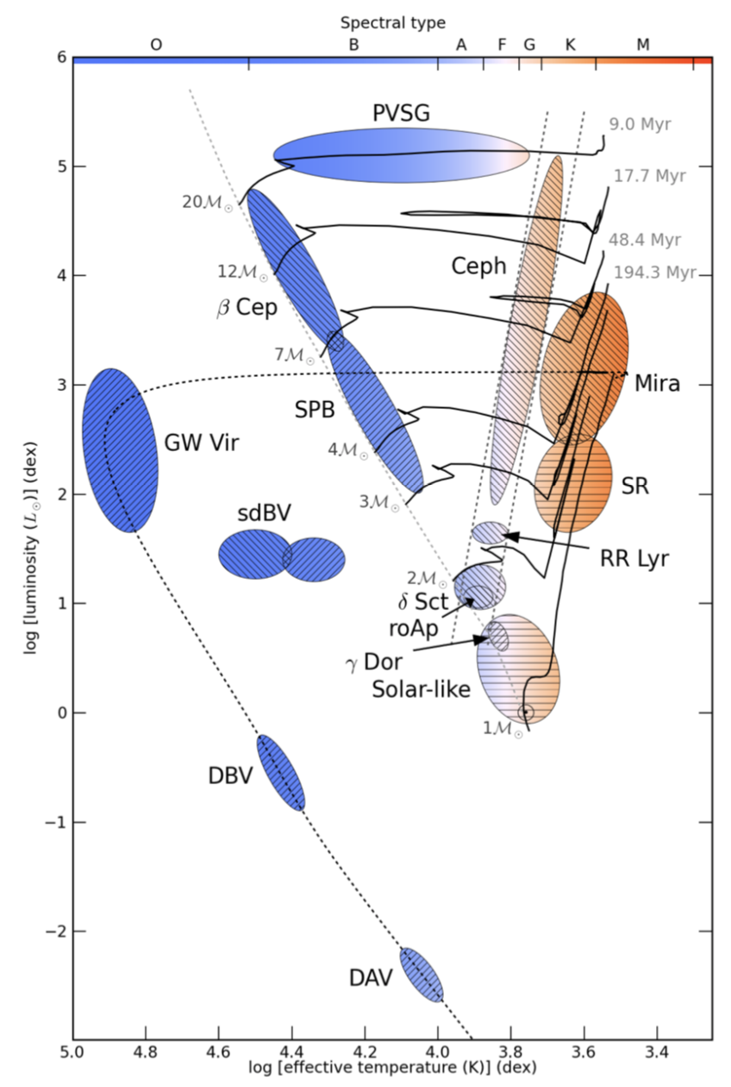
Classical Cepheids crib sheet
Evolved intermediate-mass supergiants (3 – 10 Msun, 20 – 200 Rsun)
Core He-burning (blue loop)
Radial pulsation in fundamental mode / low overtone, periods 1 – 100 d
Luminosity inference via Leavitt law
M-L relation, Stefan-Boltzmann law & period-density relation
Applications: distance ladder & galaxy structure
Age inference via period-age relation
Age depends mainly on main sequence lifetime
Applications: star formation histories, Galactic rotation
From P. Papics (2013) Credit: J. Christensen-Dalsgaard, P. Degroote

Slide 13
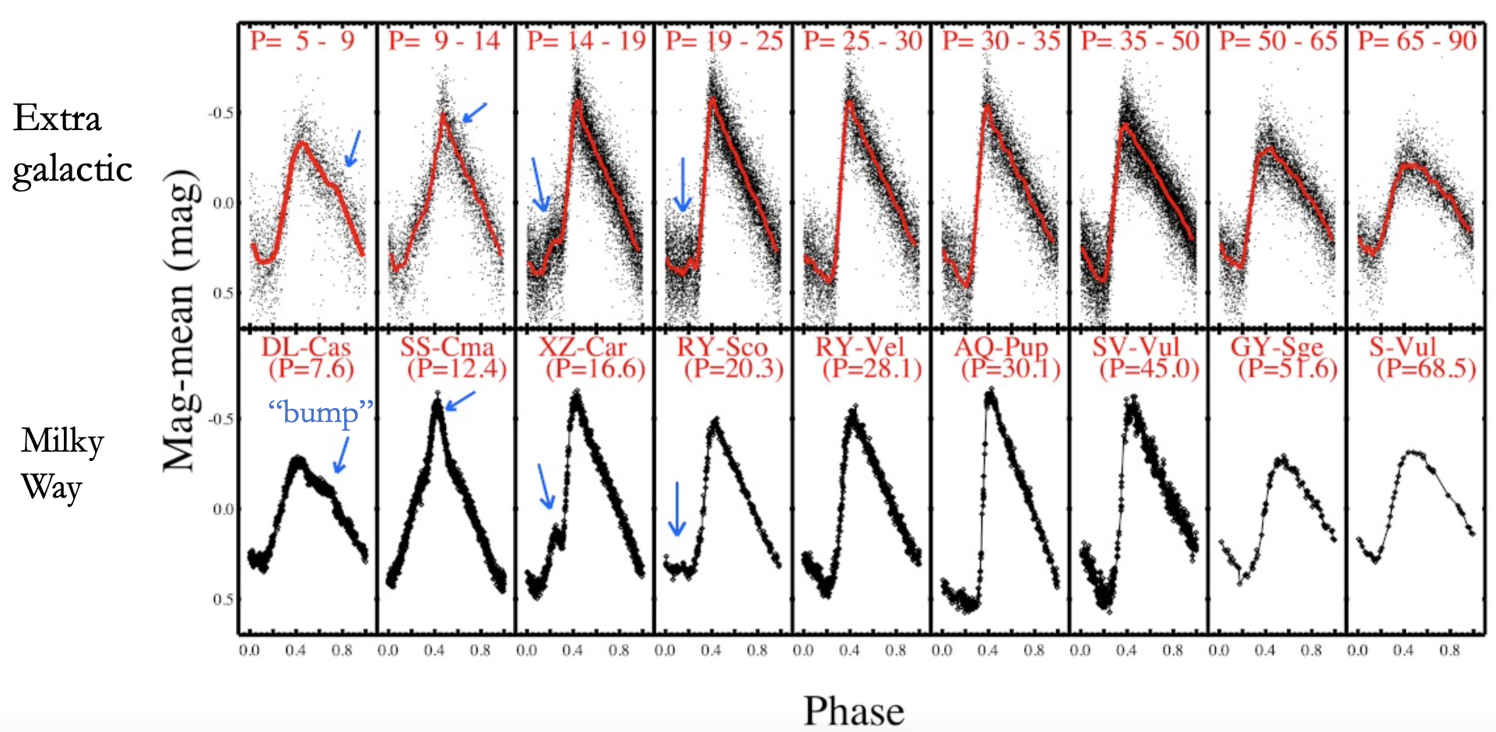
Hertzsprung progression in MW and SN-hosts

Slide 14
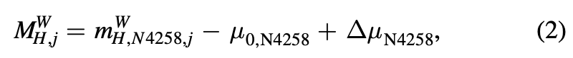
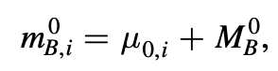
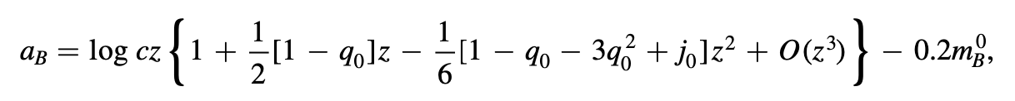
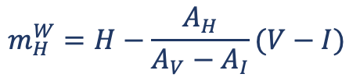
Distance Ladder Equations
Reddening-free “Wesenheit”
$$m_{H}^{W}=H−\frac{A_{H}}{A_{V}−A_{I}}(V−I)$$
observed
fiducial
Period slope
Metallicity
Leavitt law
SNeIa standardized

Slide 15
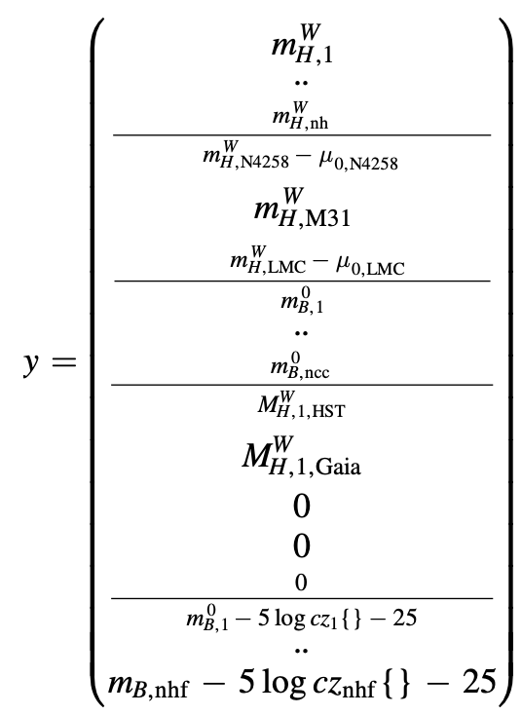
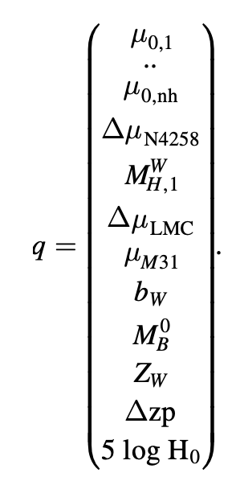
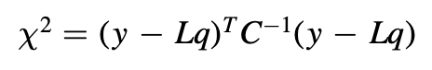
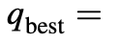
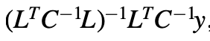
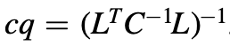
A simultaneous analytical LS fit
Covariance Matrix
observations
Model = equations * parameters

Slide 16
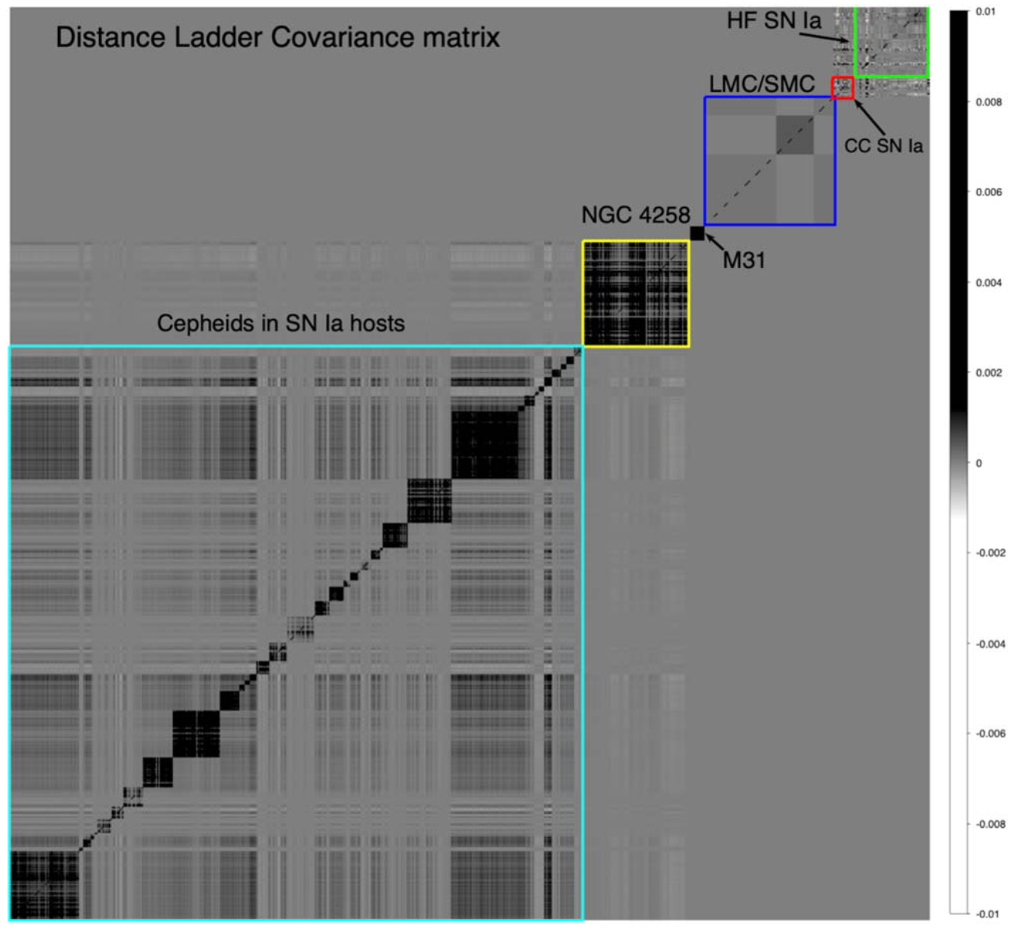
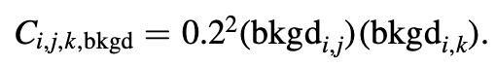
Covariance
Explicitly propagated
Metallicity!
Background
SN-SN (Pantheon+)

Slide 17
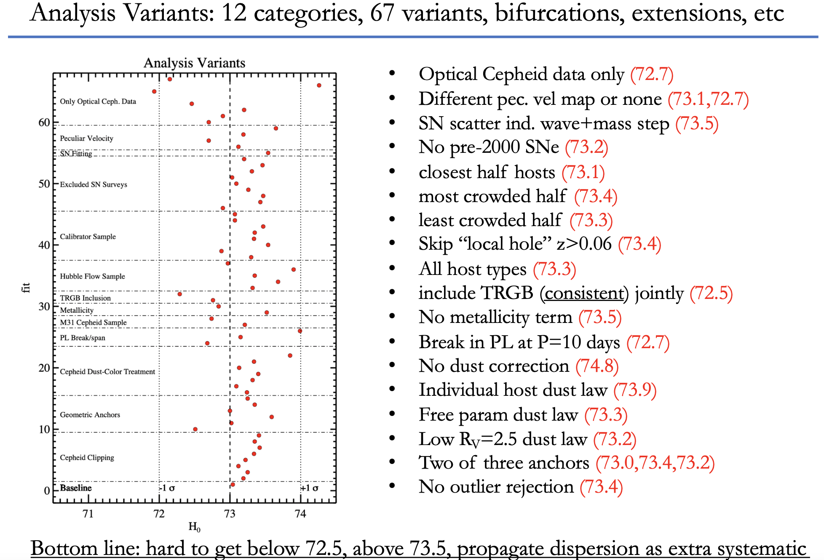

Slide 18
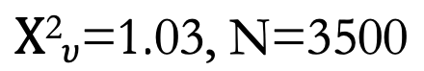
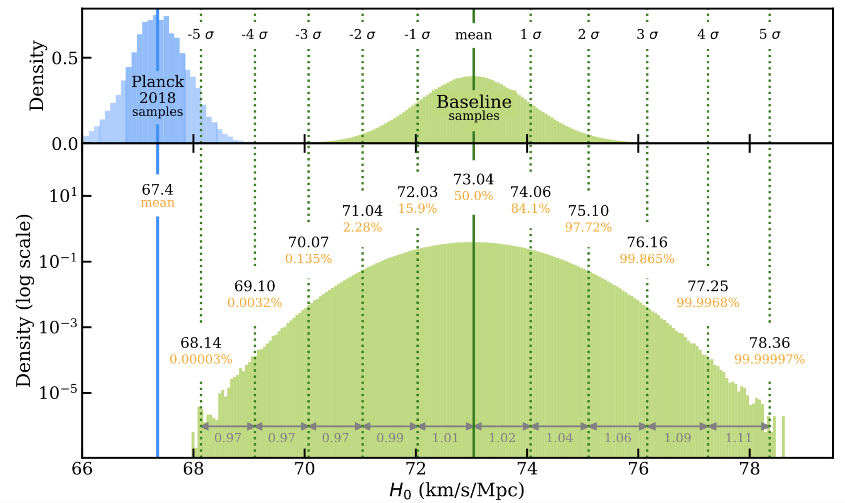
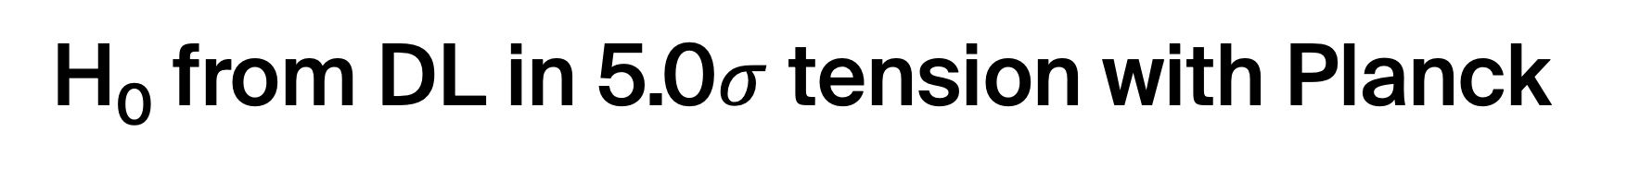
H₀ from DL in 5.0$σ$ tension with Planck
Baseline fit incl. systematics: $H_{0}=73.04±1.04 km s^{−1} Mpc^{−1}$
Riess et al. (2022) ApJL 934, L7

Slide 19
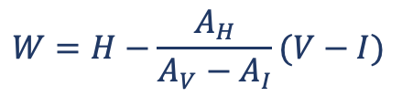
SH0ES project improvements of the distance ladder relative to HST key project
Precise differential ladder anchored to accurate geometric distances
Anchors
Geometric distances to LMC and NGC4258
Parallaxes of MW Cepheids
Photometry
Exclusive use of HST photometric system (16 mag dynamic range) +NOW JWST!
Sophisticated background corrections, validated by amplitude ratios & light curves
Experimental setup
Reduced sensitivity to reddening thanks to IR & reddening-free Wesenheit-magnitudes
Covariance included in distance ladder fit
42 SNeIa in galaxies with known Cepheids
Clean sample of > 300 SNeIa in Hubble flow
$$W=H−\frac{A_{H}}{A_{V}−A_{I}}(V−I)$$
cf. Riess et al. (2016, 2022) & refs therein

Slide 20
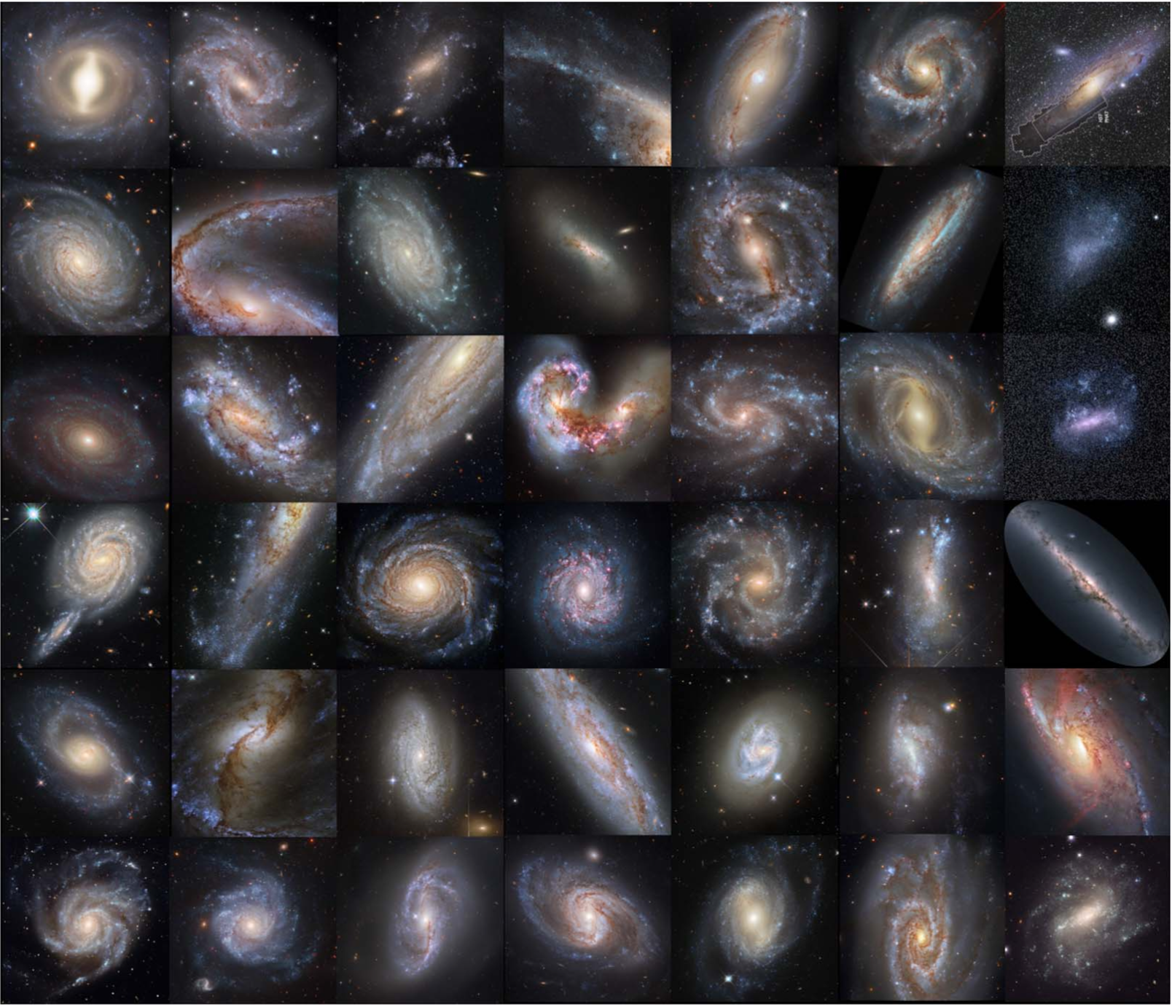
42 SNeIa in 37 galaxies w/ Cepheids
Notes:
3129 Cepheids used in the fit

Slide 21
Evolution of systematics since 2016
Gaia parallaxes: steady improvement in precision & systematics
Broken Leavitt laws have come and gone
Stellar association bias (‘physical’ crowding) RIA & Riess 18, Spetsieri, RIA+ in prep.
Binaries are no problem RIA & Riess 2018, Karczmarek+22, Shetye+ in prep.
Metallicity effect measured from high-res spectra e.g. Gieren+18, Da Silva+22, Ripepi+22, Breuval+21/22 several talks by Trentin, Hocdé, Lemasle, Breuval
Effect of reddening in Wesenheit formulation (Mörtsell+22, Riess+22)
Time dilation “Redshift-Leavitt bias” (RIA 2019: moves H0 up)
K-corrections very small (RIA 2022, moves H0 down)

Slide 22
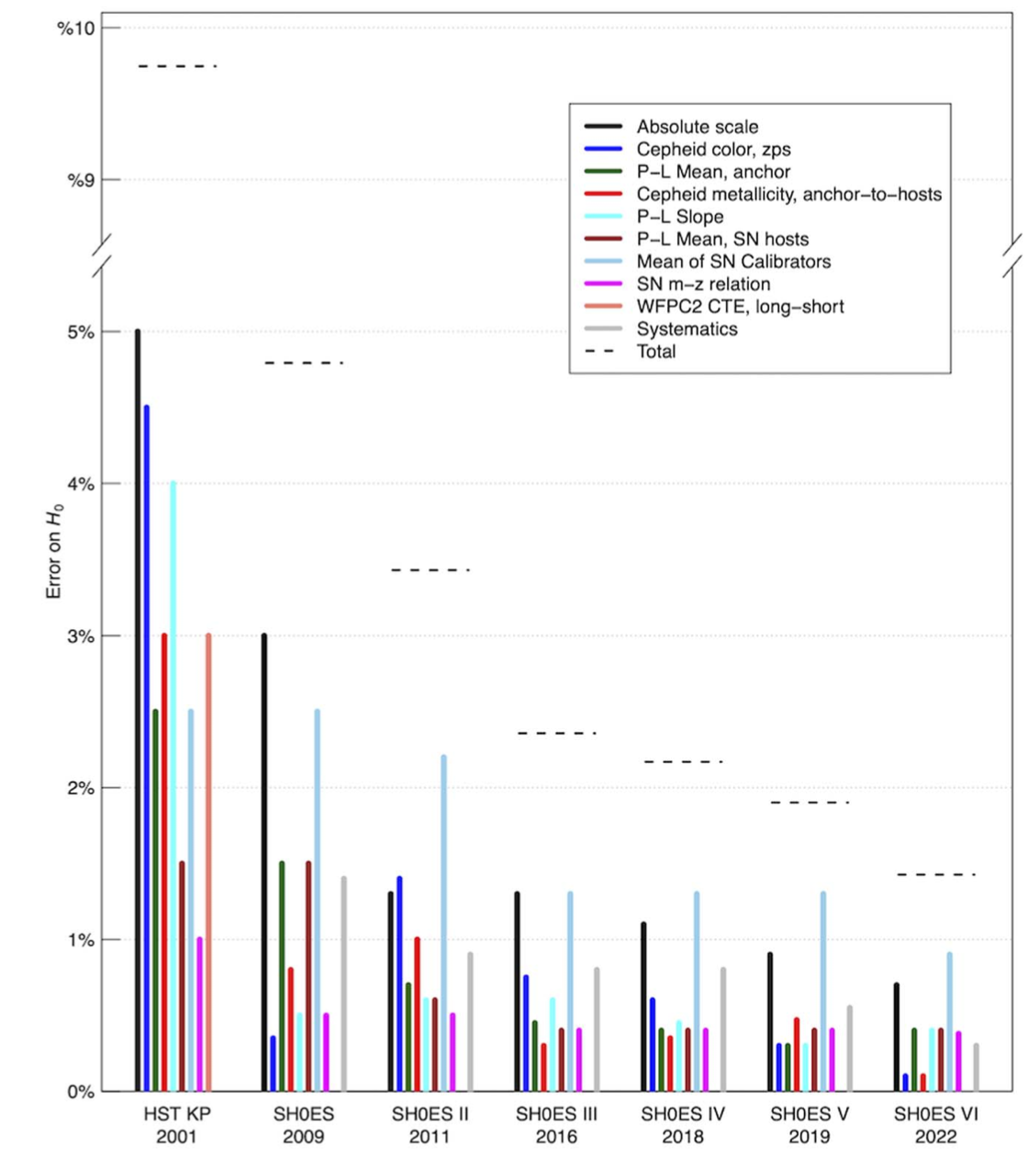
Uncertainties improve, tension grows

Slide 23
Crowding
Corrections already applied in SH0ES DL (artificial star tests) Null tests imply no crowding problem Amplitude-based tests performed Quality cuts (amplitude ratios, colors, etc.) protect against this

Slide 24
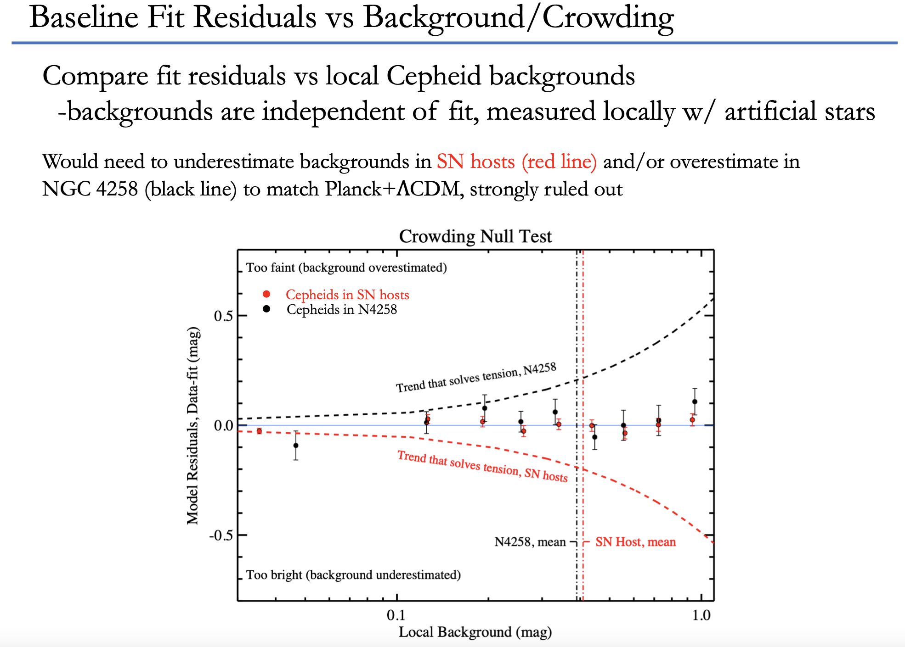
Riess+2022

Slide 25
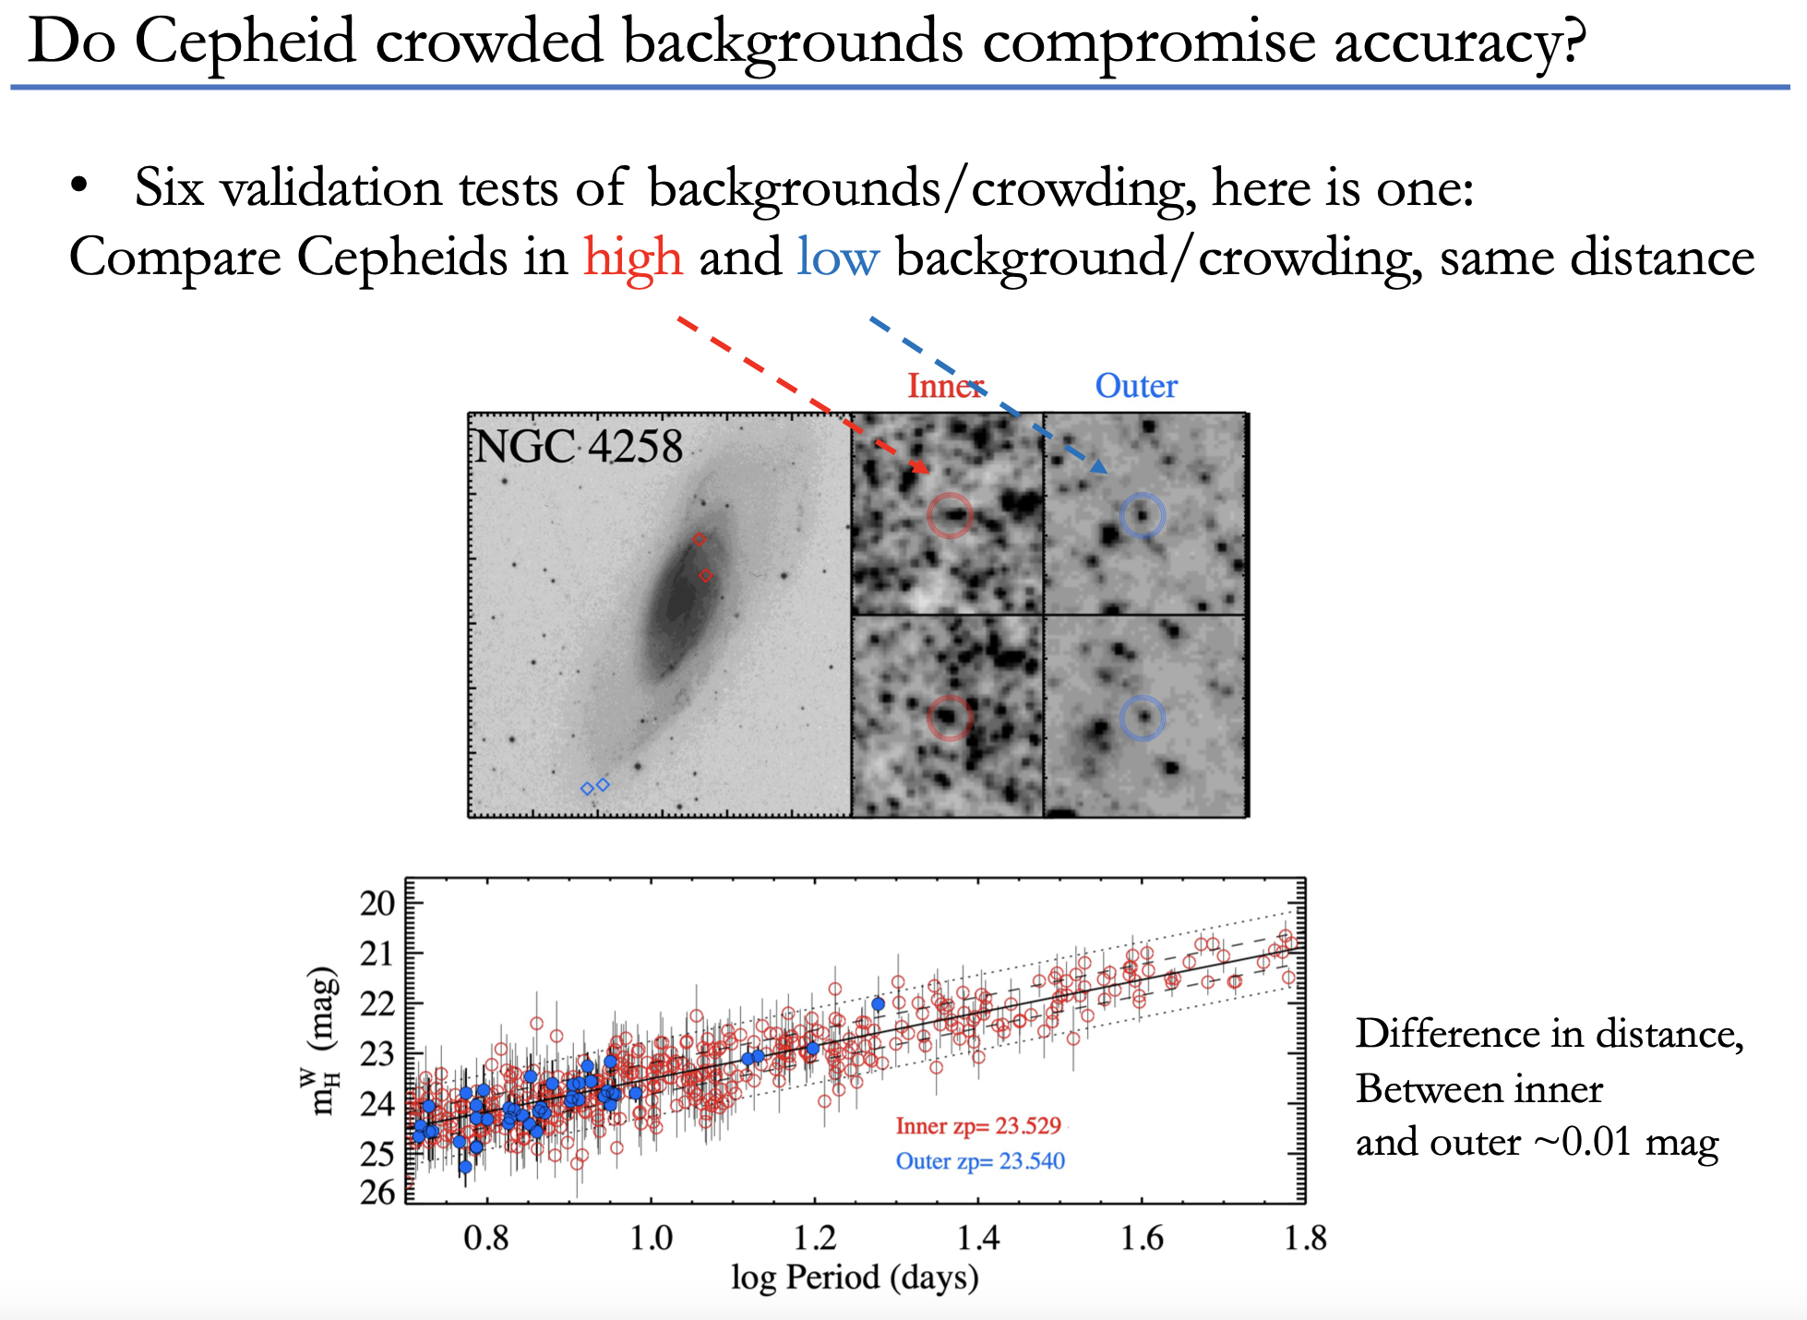
Riess+2022

Slide 26
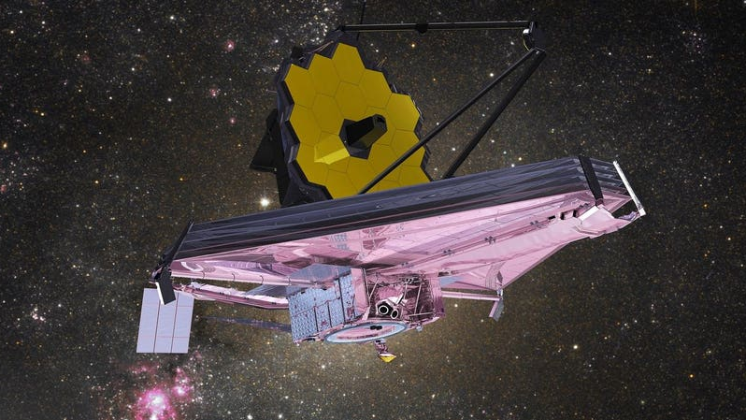

Slide 27
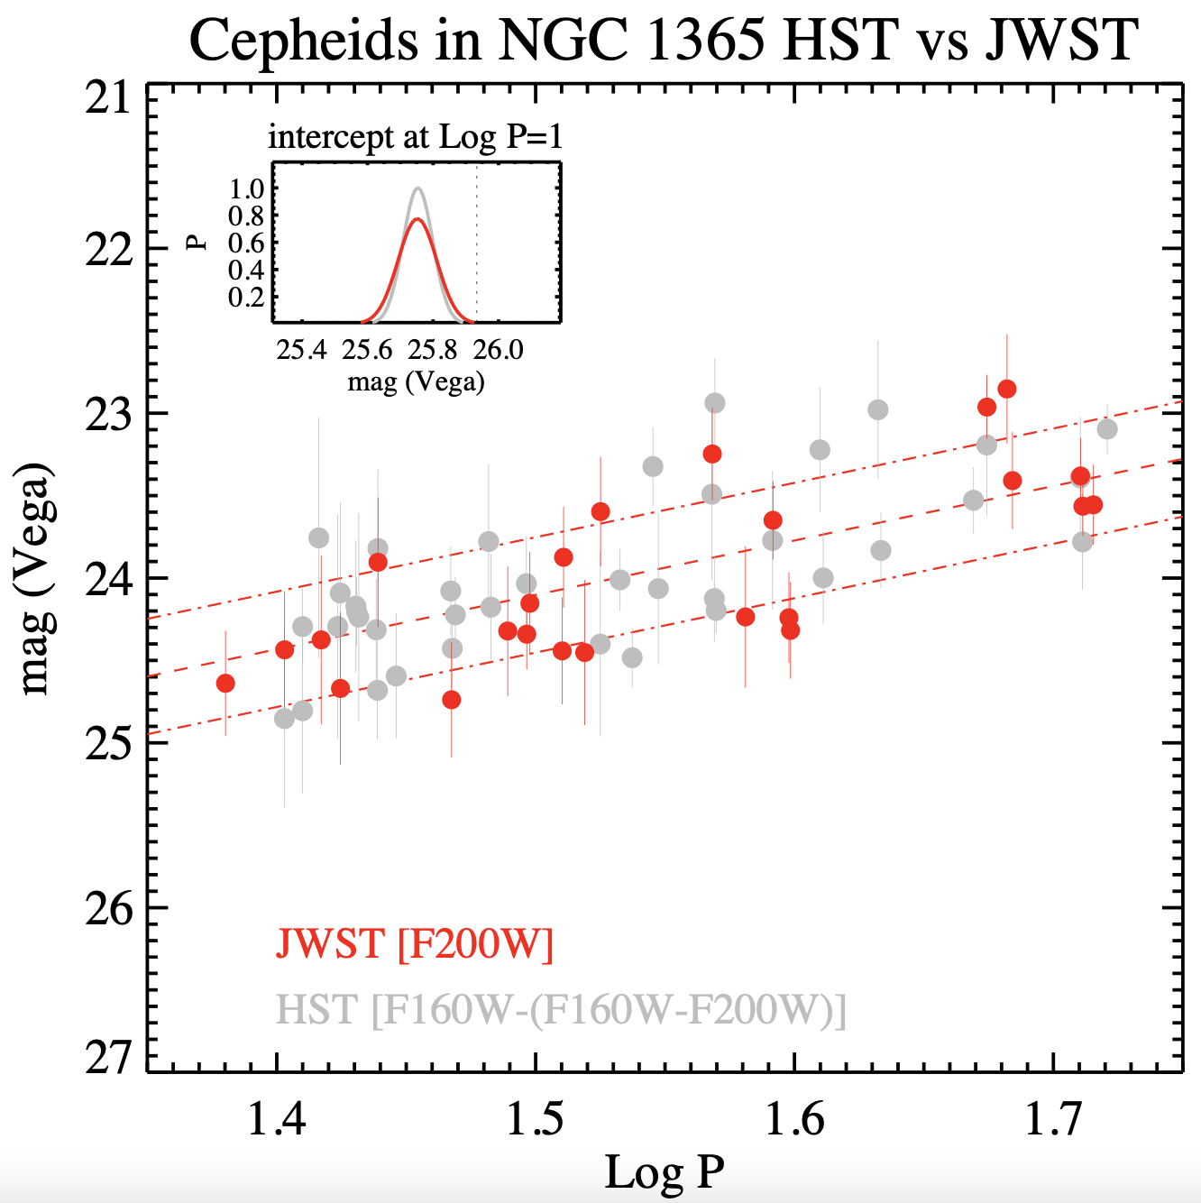
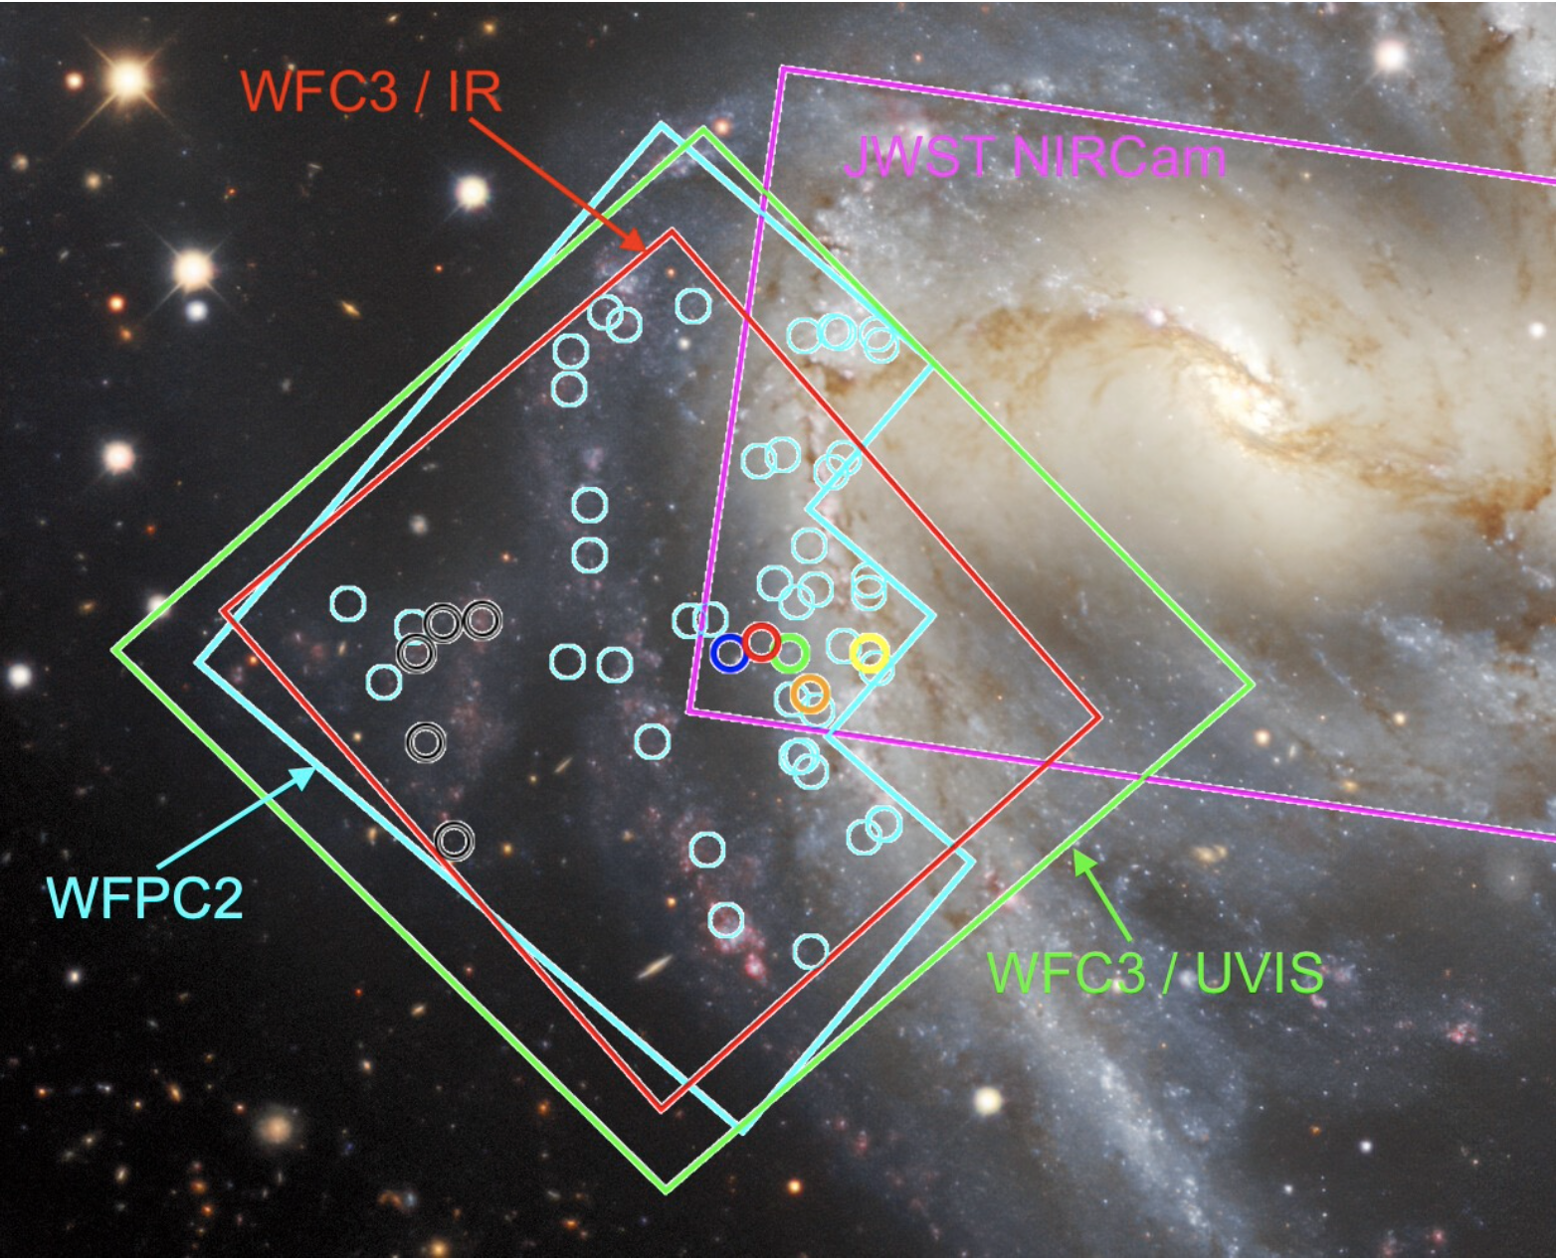
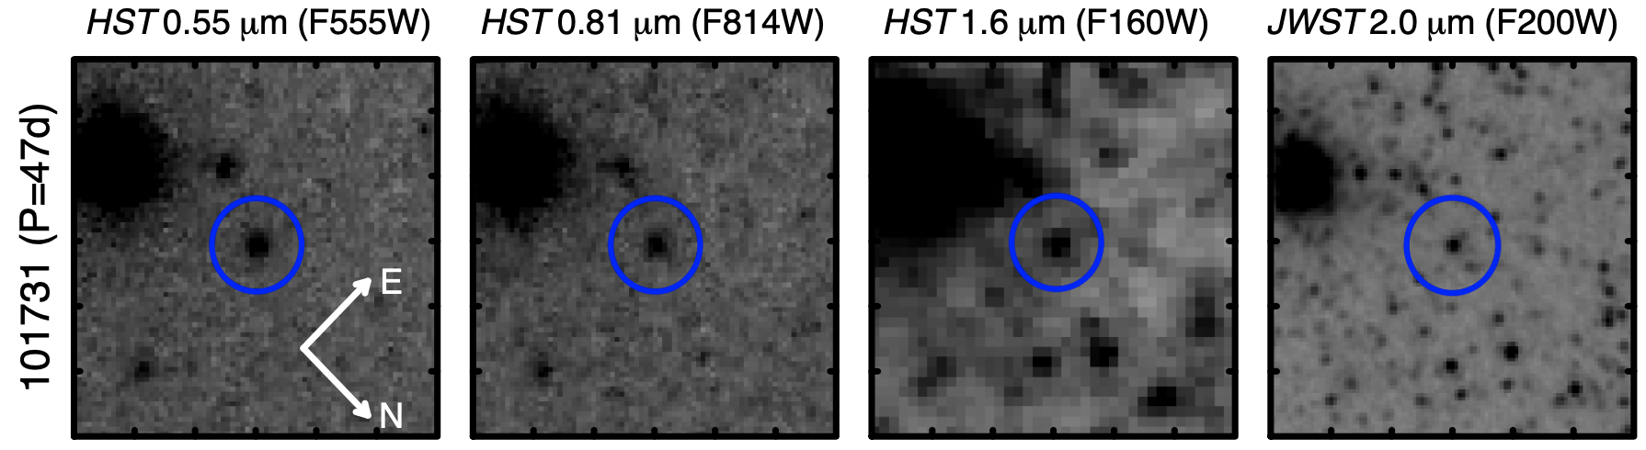
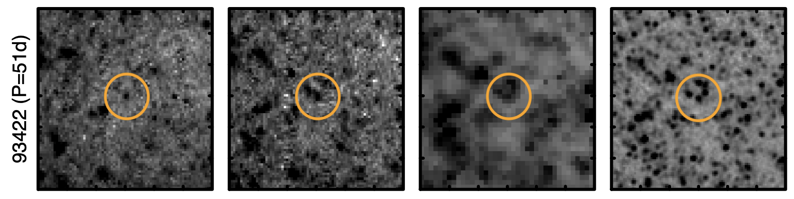


JWST sneak preview: uncrowding Cepheids in the IR
Yuan et al. 2209.09101
Serendipitous observations: limited precision
Cepheids are not biased bright
Targeted observations to come
$$25.74±0.04$$
$$25.72±0.05$$

Slide 28

JWST uncrowds distant Cepheids
Riess et al., incl RIA (2023), ApJL 956, L18
JWST : NIR spatial resolution slightly better than optical HST, 4x better than NIR HST
Better source separation = lower uncertainty from crowding correction
HST + JWST synergy: Optical and NIR photometry observed using similar spatial resolution
Spoiler alert: Crowding does not solve the Hubble tension

Slide 29


JWST: HST unbiased & 2.5x less dispersion
Riess et al., incl RIA (2023), ApJL 956, L18

Slide 30
Metallicity
See Louise’s talk?

Slide 31


Metallicity
Credit: L. Breuval
MW
Riess+2022a

Slide 32




Correction included in 2022 SH0ES result
Time dilation
RIA, A&A 631, A165 (2019)
12
$$z_{obs}$$
9
3
6
12
9
3
6
12
9
3
6
$$M=α+β\log{P}$$
$$z_{obs}≈0$$

Slide 33

New insights on TRGB calibration and standardization

Slide 34








TRGB calibration of the distance ladder
Absolute calibration of $M_{TRGB}$
Calibrating SNIa M_{B} using $μ_{TRGB}$
Tracing Hubble flow $μ_{SNIa}$
$$μ$$
Credits: Freedman et al. (2019), Freedman (2021), Hoyt et al. (2019), ESO

Slide 35

Individual and statistical standard candles
Tip of the Red Giant Branch

Slide 36

Note on calibration & standardization
All standard candles require calibration and standardization
Calibration: determines fiducial luminosity & how to standardize
Standardization: corrects observed samples to match fiducial
Leavitt law calibration:
Fiducial M: 10d Cepheid, Solar metallicity, H-band Wesenheit magnitude
Standardization: LL slope, metallicity difference, time dilation, etc. => all well calibrated and measurable (directly or by proxy)
LL scatter usefully constrains uncertainties
TRGB:
Fiducial M: statistically determined inflection point of mixed-population luminosity functions, mostly in I-band (F814W)
Standardization: metallicity & age differences, algorithmic choices, etc. => no consensus, but good recent progress
$${10}^{29}−{10}^{30}W$$
log(P)

Slide 37


TRGB location matters
Csörnyei, RIA et al. 2305.13943
Independent 3-4% distances by Cepheids & type-IIp SN (EPM) agree
TRGB distance too large & not measured in halo

Slide 38

Scolnic et al. (2023)

Slide 39

Anand et al. (2021)

Slide 40

Reconciling standard candles?
?

Slide 41



Bias due to LF smoothing
RIA et al. 2303.04790 (to be updated)
$$\left|\frac{dm_{I}}{dσ_{s}}\right|≤0.1$$

Slide 42


Sobel filters, smoothing parameters, edge responses, and bias
RIA et al. 2303.04790 (to be updated)
EDR = edge detection response
$m_{TRGB}=mode(EDR)$
Sobel filter (unweighted): $EDR=S\left(i\right)=N\left[i−1\right]−N\left[i+1\right]$
Poisson weighting: $EDR=S(i)/\sqrt{N\left[i−1\right]+N\left[i+1\right]}$
SNR weighting: $EDR=S{\left(i\right)}^{2}/\sqrt{N\left[i−1\right]+N\left[i+1\right]}$
Problem 1: correlation among bins
Problem 2: weighting shifts EDR mode, creates tip contrast relation (TCR)
Standardization needed for weighted EDRs

Slide 43




Standardizing m_{TRGB}
Wu et al. (2022), Scolnic et al. incl. RIA (2304.06693)
N₋
N₊
$$m_{I,TRGB}^{R=4}=m_{I,TRGB}−0.021(R−4)$$
R = N₊/N₋

Slide 44

CCHP mainly disagrees with SH0ES because of SNeIa!
Scolnic et al. (2023)

Slide 45


The TRGB is chock-full of variable stars
RIA et al. 2303.04790 (to be updated)
79’200 Small Amplitude Red Giants in OGLE-III
Aseq
Bseq
OSARGs
Ita et al. (2002); Kiss & Bedding (2003)
Notes:
$A_{I}∼20$ mmag, Nobs ~ 550, 𝛔_{i} ~ 3-6 mmag
Photometric errors in OGLE, ca. 6 mmag at I = 15 mag, 10mmag at 16
Avg amplitude 0.015 mag +/- 0.008 mag; min amplitudes reported are 0.002 mag.
Aseq avg amplitude 0.017 mag, Bseq avg 0.022 mag

Slide 46


Twigs of the Red Giant Branch
RIA et al. 2303.04790 (to be updated)
79’200 Small Amplitude Red Giants in OGLE-III
A & B sequence differ by 4.5–5 sigma!
Bseq
Aseq
OSARGs
Ita et al. (2002); Kiss & Bedding (2003)
Notes:
$A_{I}∼20$ mmag, Nobs ~ 550, 𝛔_{i} ~ 3-6 mmag
Photometric errors in OGLE, ca. 6 mmag at I = 15 mag, 10mmag at 16
Avg amplitude 0.015 mag +/- 0.008 mag; min amplitudes reported are 0.002 mag.
Aseq avg amplitude 0.017 mag, Bseq avg 0.022 mag

Slide 47

Variability elucidates RG diversity and allows standardization
RIA et al. 2303.04790 (to be updated)
Ages from Povick et al. (2306.06348)

Slide 48


Twigs of the Red Giant Branch
RIA et al. 2303.04790 (to be updated)
RGBs are diverse stellar populations. Variability-based selections yield multiple TRGB magnitudes!
$4.5σ$ difference between Aseq & Bseq!

Slide 49

Twigs of the Red Giant Branch
RIA et al. 2303.04790 (to be updated)
OSARGs yield most precise TRGB calibration in LMC to date
Calibration consistent with three independent, non-LMC TRGB calibrations in NGC4258, EDD calibration (Rizzi+2007), and Gaia parallaxes
Applicable to H0 since all stars at Tip are OSARGs
Variability not relevant for TRGB magnitude
Variability enables further investigations
$4.5σ$ difference between Aseq & Bseq!

Slide 50

Improved systematics increase TRGB-calibrated H0!
TRGB method improvements (smoothing, weighting, objectivity), population diversity, Tip-contrast-relation, Host galaxy reddening, Pantheon+ SNe, and more

Slide 51



Main aims:
establish synergy between areas focusing on cosmological tensions
foster interdisciplinary network
confront growing challenges of tensions in cosmological surveys
Focus on inclusion across member countries and key communities
Leads: Jackson Levi Said (Malta) Eleonora Di Valentino (Sheffield)
www.cost.eu/actions/CA21136
youtube.com/ @cosmoverseseminars2112

Slide 52

https://link.springer.com/book/9789819901760

